Slide 1
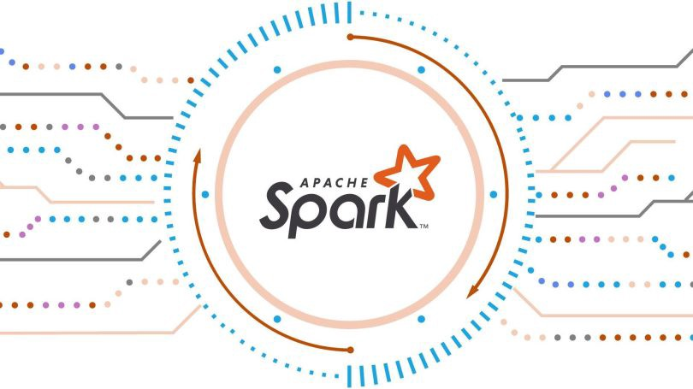

Slide 2

Agenda
Discuss about need of Apache Spark
What is Apache Spark
Components of Apache Spark
What is interactive Shell
What is PySpark
Installation of Apache Spark
What is RDD
Architecture of RDD
What is DAG
What is DAG scheduler and Task Scheduler
Apache Spark Architecture
Implementation of RDD
Features of Apache Spark
Application of Apache Spark
Running Platform for Apache Spark

Slide 3
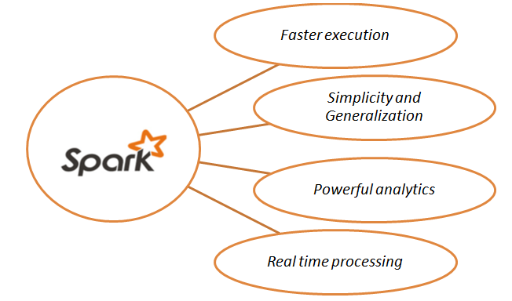
Need of Apache Spark
High speed data querying, analysis, and transformation with large data sets.
Compared to MapReduce, Spark offers much less reading and writing to and from the disk, multi-threaded tasks.
Great for iterative algorithms
Super fast, especially for interactive queries.
(100x faster than classic Hadoop Hive queries without refactoring the code!)
Supports multiple languages and integrations with other popular products.
Helps make complex data pipelines coherent and easy.

Slide 4

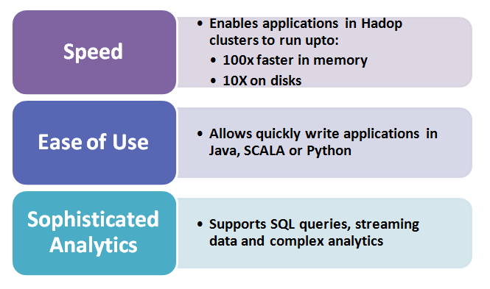
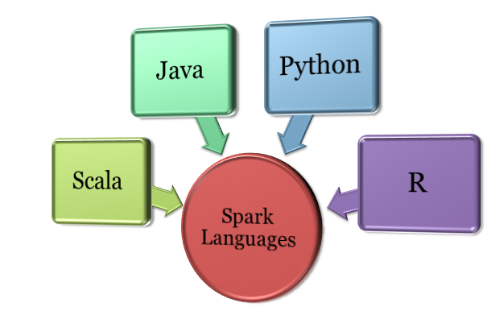
What is Apache Spark?
What is Spark?
Apache Spark is an open-source analytics engine for large-scale data processing to store and process data in real time.
Comparison between Hadoop and Spark :

Slide 5
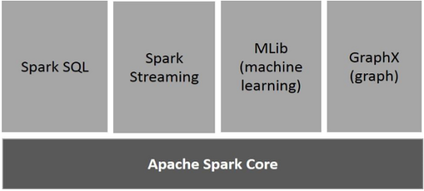
Components of Spark Apache

Slide 6




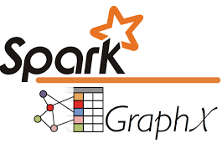
Spark Core : Contains basic functionality of Spark.( task scheduling, memory management, fault recovery, interacting with storage systems)
Spark SQL : It is used for structured and semi-structured data processing.
Spark Streaming : It is working on data which is in Motion.
MLlib : Provides multiple types of machine learning algorithms.
GraphX : GraphX is Spark’s own Graph Computation Engine and data store.

Slide 7
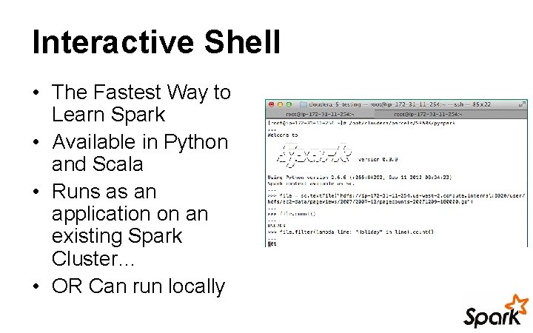
Scala : To start interactive shell in scala use command spark-shell. Pyspark : To start interactive shell in pyspark use command pyspark. Java : No interactive shell is available because java is programming language.

Slide 8
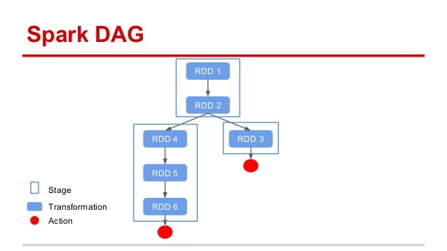
DAG
: Directed Acyclic Graph
Dag is a graph denoting the sequence of operations that are being performed on the target RDD.

Slide 9




Resilient Distributed Dataset
RDD ( Resilient Distributed Dataset )
Resilient: Restore the data on failure.
Distributed: Data is distributed among different nodes.
Dataset: Group of data.
RDD
Transformation
Action
These are operations (such as map, filter, join, union) that are performed on an RDD that yields a new RDD containing the result
These are operations (such as reduce, first, count) that return a value after running a computation on an RDD

Slide 10
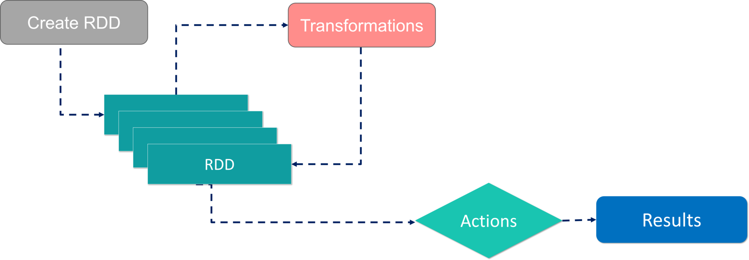
Working with RDD’s
Spark architecture is based on two abstractions:-
Resilient Distributed Dataset (RDD)
Directed Acyclic Graph (DAG)
Transformations :
a = sc . textFile(“hdfs://. . . . . /abc . txt”) →RDD0
b = a.filter( . . . . . ) →RDD1
c = b.distinct( . . . . . ) →RDD2
Actions :
c . collect ()
Data Source

Slide 11
DAG scheduler
f
Slave 1
executer
Task slot
Stage 1
RDD1
RDD2
Task slot
task
Task schedular
CM
RDD3
task
RDD4
Stage 2
Slave 2
executer
task
task
RDD5
Task slot
task
DAG in Spark
Spark creates a graph when we enter code in spark console.
When an action is called on Spark RDD , Spark submits graph to DAG schedular.
Operators are divided into stages of task in DAG scheduler.
Task slot
Task slot

Slide 12
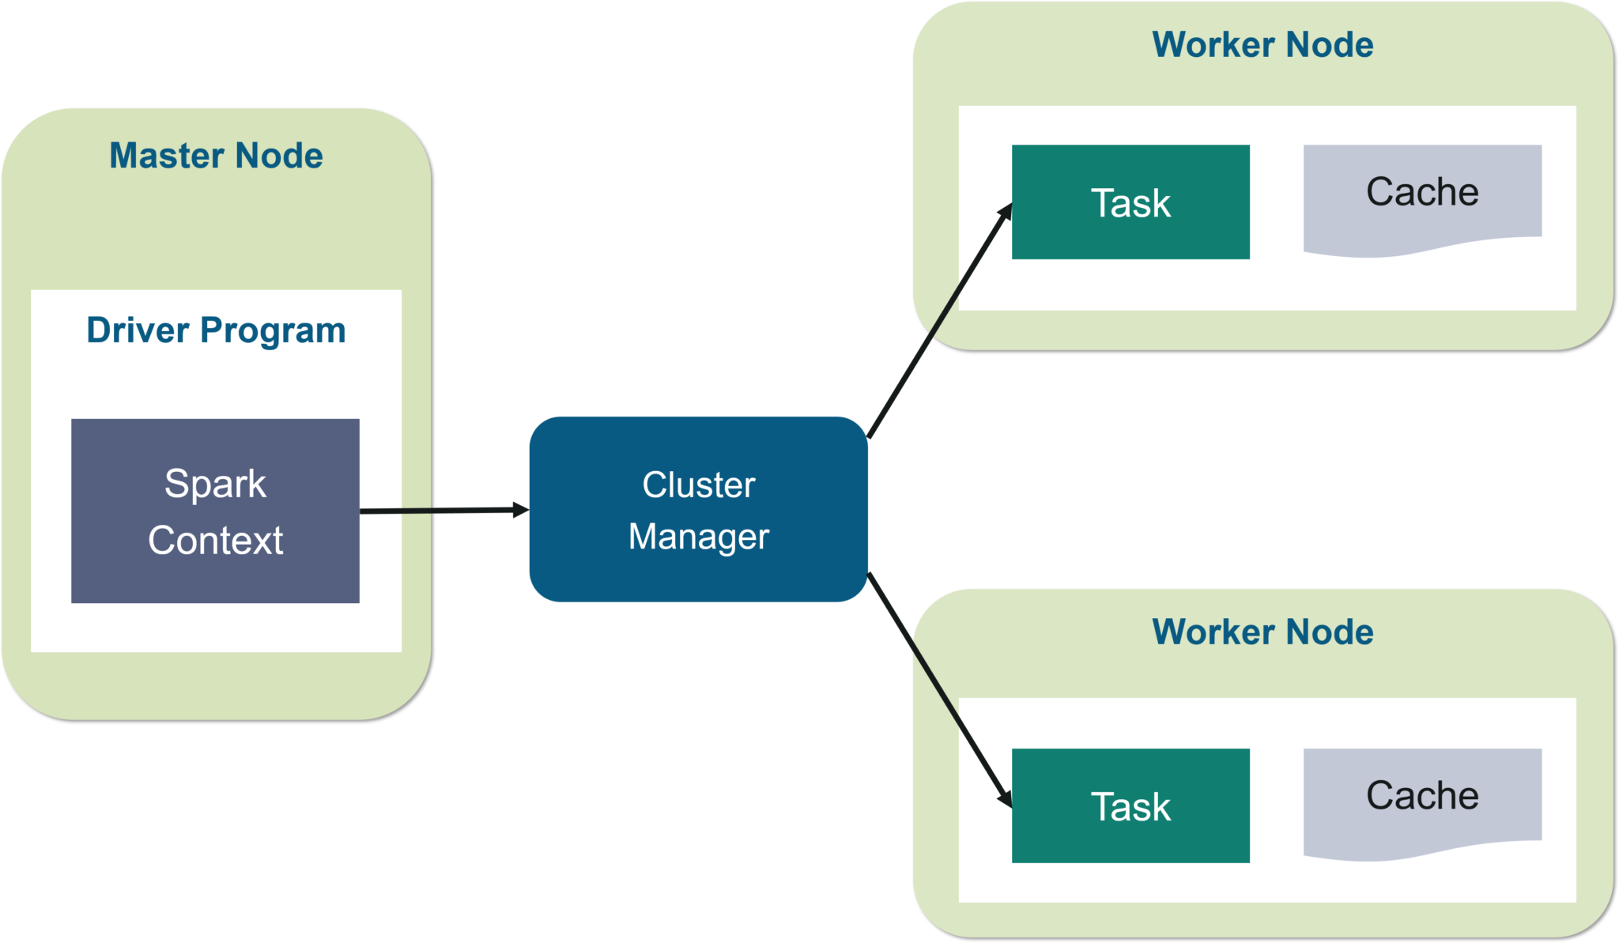
Spark Architecture

Slide 13

Spark context
Master Node has a Driver program, it’s use to implementation on schedular.
Driver program
It is run on master system and as well as negotiate with the cluster manager for scheduling the task.
Cluster manager
It’s allocate resources to task.
Master Node
The Spark Master is the process that requests resources in the cluster and makes them available to the Spark Driver.

Slide 14
Spark Session It provides a way to interact with various spark's functionality with a lesser number of constructs. Deployment Mode Client Mode : When the driver runs on the host where the job is submitted, that spark mode is a client mode. Cluster Mode : When the driver runs in the application master on a cluster host, which YARN chooses, that spark mode is a cluster mode. Worker Node Worker node refers to node which runs the application code in the cluster. Worker Node is the Slave Node.

Slide 15
Executor Once they have run the task they send the results to the driver.
Task A task is a computation on a data partition in a stage of a RDD in a Spark job.
Stages Stages are created on shuffle boundaries: DAG scheduler creates multiple stages by splitting a RDD execution plan/DAG
Jobs When invoke an action on RDD, a job is created. Jobs are the main function that has to be done and is submitted to Spark.

Slide 16
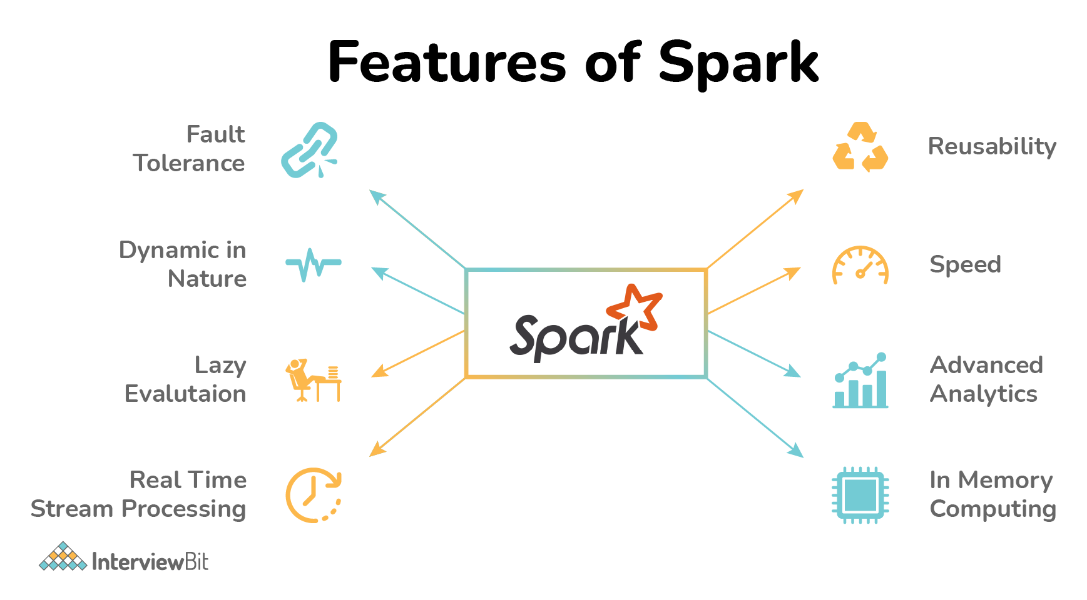






Slide 17

Application of Spark
Banking
E-Commerce
Healthcare
Entertainment

Slide 18

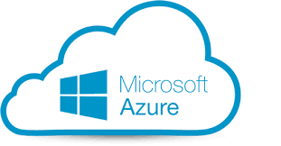

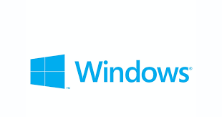


Support platform to run spark application on cloud Support OS platform for spark

Slide 19
THANK YOU

